Slide 1
Welcome to RP CoderDojo
Creative, Fun Coding

Slide 2
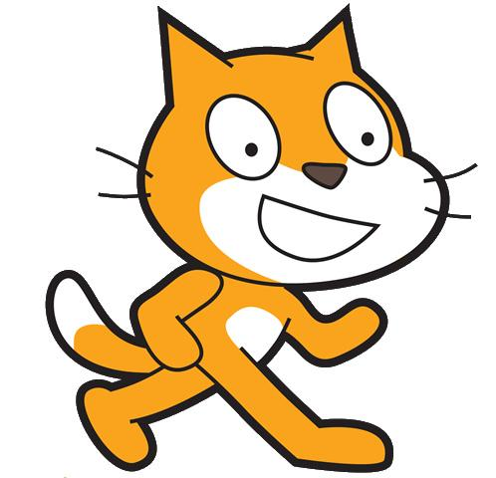


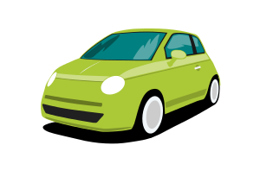
Introduction to Coding
?
Notes:
What is coding and Why learn about coding
Like Art and Music create something using a “medium, tool” like canvas, piano
Coders are artists expressing their creativity
We watch videos on YouTube, Play other’s games like minecraft. Why not create something of your own to share with others.
Computers in our lives all around us. in stores, in cars, in TVs. and more coming everyday
Things we will be doing create games, movies, slide shows, apps
Tools we will work with, scratch, html, javascript, python

Slide 3
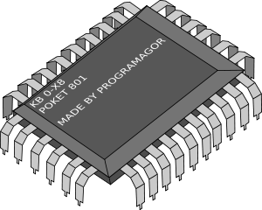


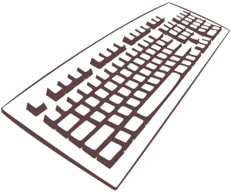
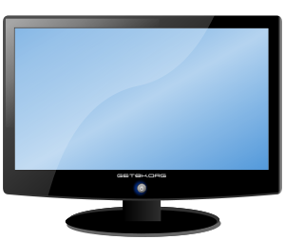
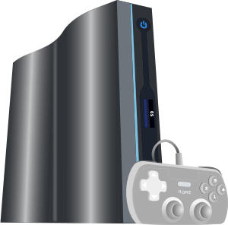
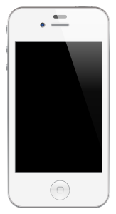
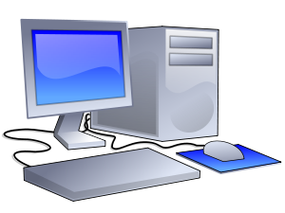
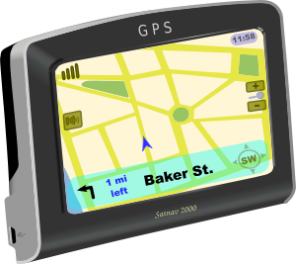
Main parts of a computer
Parts of the computer are
?
Notes:
Why do we need to know the parts of a computer. Apps work with different parts
Parts of the computer are:
CPU - does all the work
Memory - stores the App to run
Input / Output - reads information from us to do work
Different types of computers - phones, game console, desktops/laptops, GPSes

Slide 4

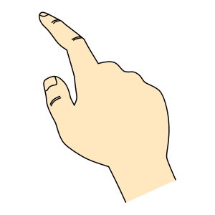
What’s an App
wait for call key
read phone #
connect to 3G network
Send phone # thru 3G
wait for answer
keep connection on
wait for end call
Read GPS
wait for key
read key
what key
put key in memory
show key on screen
repeat
Notes:
A computer would not be able to do anything without apps
Everything you use on a computer is an app
An app is a set of instructions that makes a computer do something
Apps can be: games, created to use a particular part of the computer such as a GPS, do some complicated math

Slide 5
About Scratch
http://vimeo.com/29457909
Notes:
Scratch is the programming language we will start coding with

Slide 6

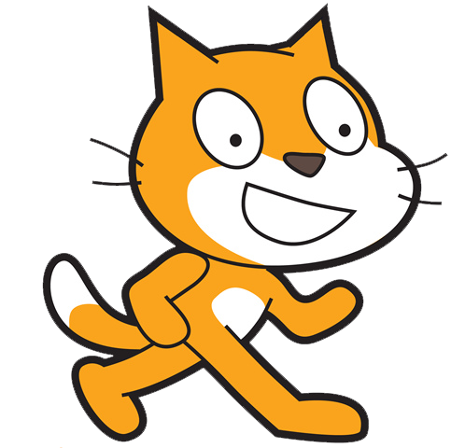
Intro to Scratch
http://scratch.mit.edu
Notes:
Scratch is a programming language developed at MIT
It allows you to build programs by snapping blocks together
Includes all the basic programming tools coders need such as Loops, If Else, variables, Input/Output, Math
Loops tell computer to do something over and over
if else helps the computer decide what to do
input/output lets the computer read and display information from the user (person using the computer)
Math - lets the computer solve math problems like adding subtracting really fast
Scratch is available anywhere from an internet browser at: http://scratch.mit.edu

Slide 7
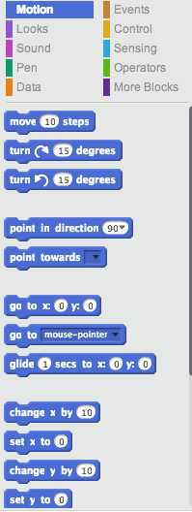
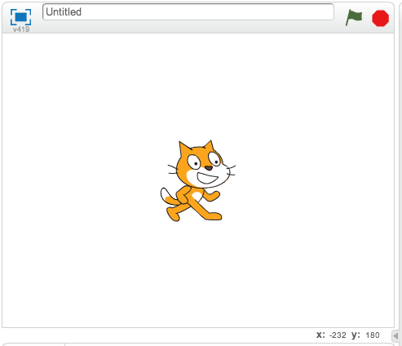
Parts of Scratch
Sprites
Stage
Scripts
Notes:
Sprites - A graphic character
Stage - Where All the action of your app takes place
Scripts - The code you will use to program your app
Backdrops - A background image for your stage
Costumes - A way to change the look of your sprites
Work area - Where you place your code blocks

Slide 8
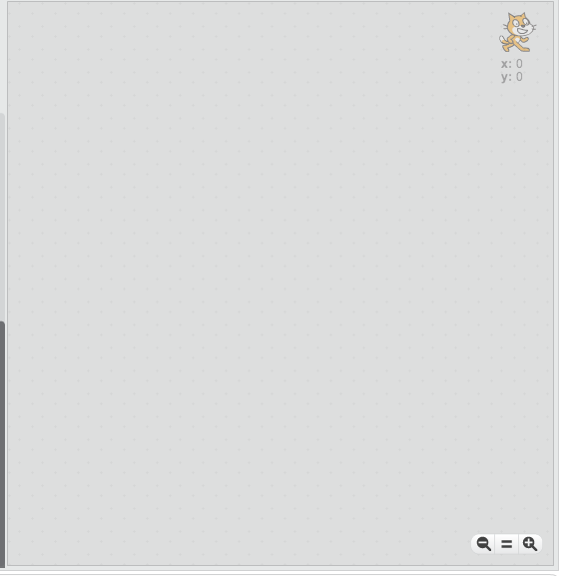
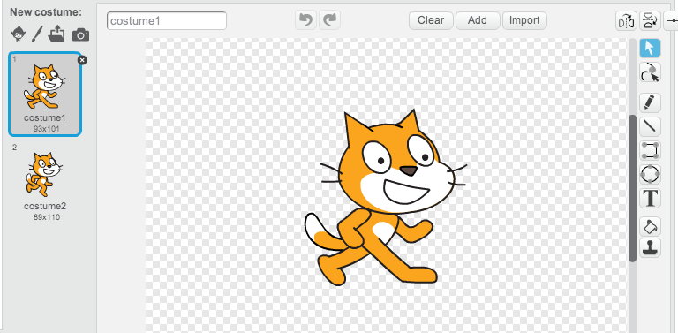

Parts of Scratch
Backdrops
Costumes
Work Area
Notes:
Sprites - A graphic character
Stage - Where All the action of your app takes place
Scripts - The code you will use to program your app
Backdrops - A background image for your stage
Costumes - A way to change the look of your sprites
Work area - Where you place your code blocks

Slide 9
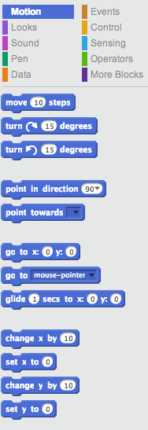
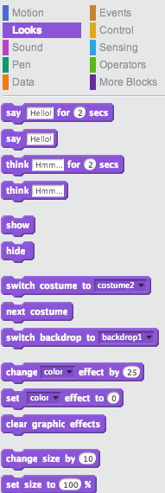
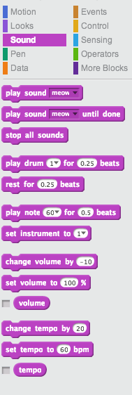
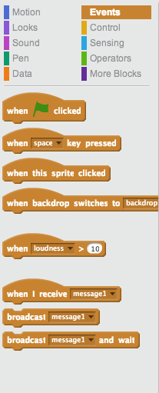
Types of Scratch Blocks
Notes:
Motion (Dark Blue) - Changes position of sprites
Looks (Dark Purple) - Changes the appearance of sprites
Sound (Purple) - Add sound effects to your app
Events (Brown) - Things that happen in the app
Control (Yellow) - Manages what an app does
Sensing (Light Blue) - Check interaction between sprites on the stage, input from mouse and keyboard
Operators (Green) - Performs math operations in app

Slide 10
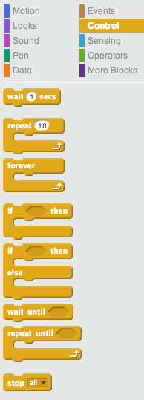
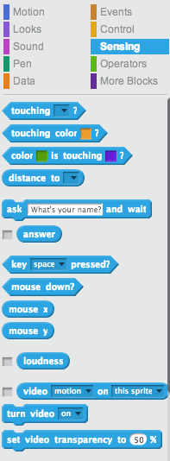
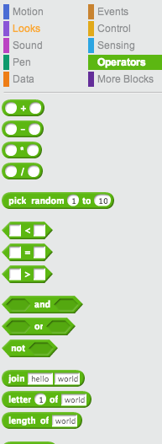
Types of Scratch Blocks
Notes:
Motion (Dark Blue) - Changes position of sprites
Looks (Dark Purple) - Changes the appearance of sprites
Sound (Purple) - Add sound effects to your app
Events (Brown) - Things that happen in the app
Control (Yellow) - Manages what an app does
Sensing (Light Blue) - Check interaction between sprites on the stage, input from mouse and keyboard
Operators (Green) - Performs math operations in app

Slide 11
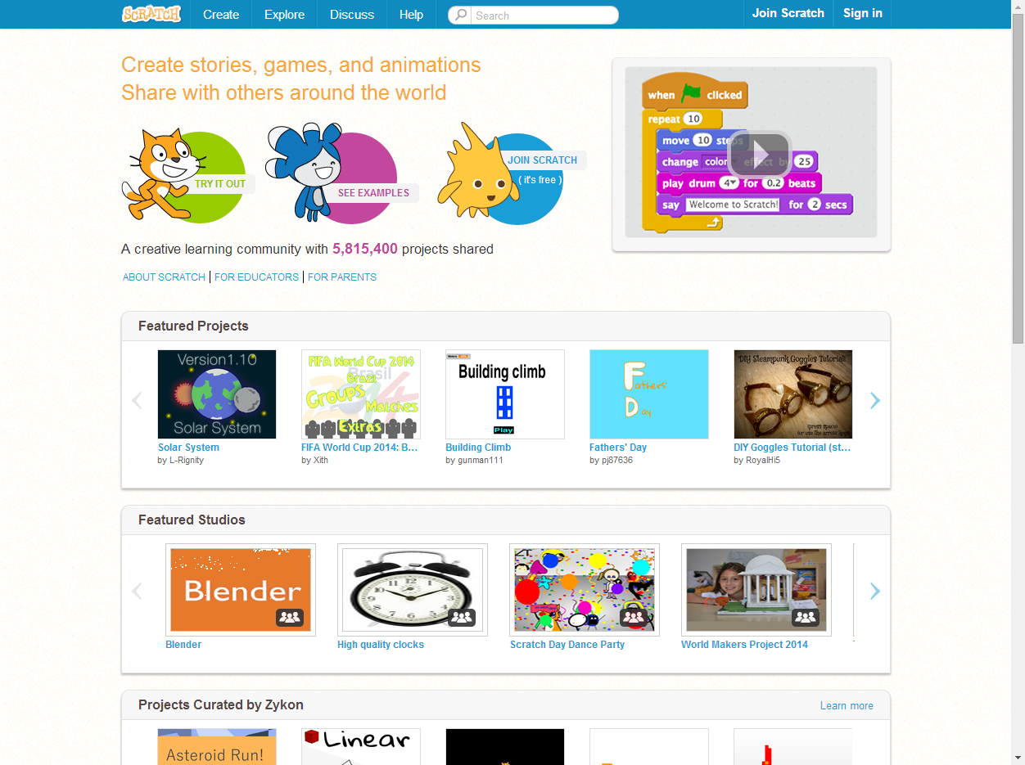
This is Scratch
Open Internet Browser and goto this URL:
http://scratch.mit.edu

